Slide 1
DS基礎
Week1_DAMDAO Answers

Slide 2
Week1_DAM

Slide 3
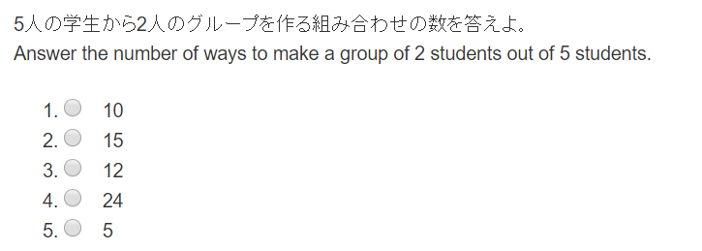

Slide 4
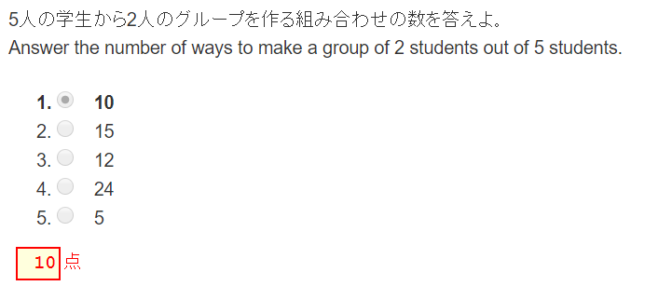


Slide 5
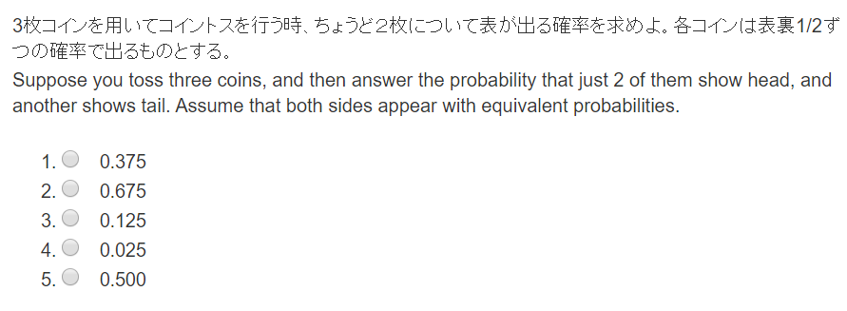

Slide 6
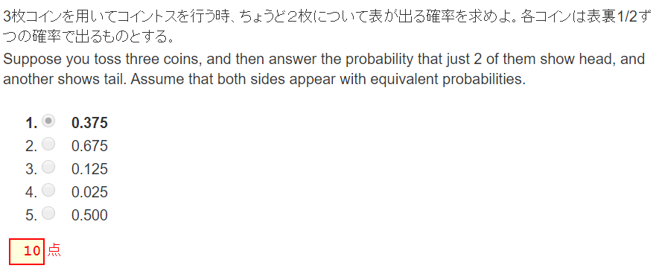

Slide 7
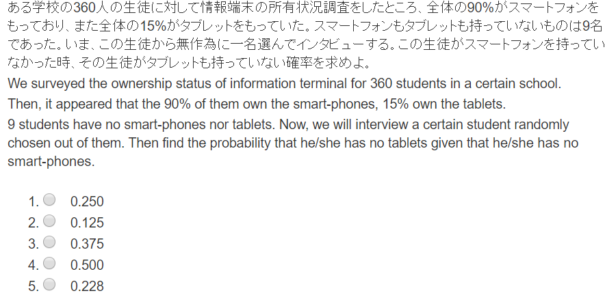

Slide 8
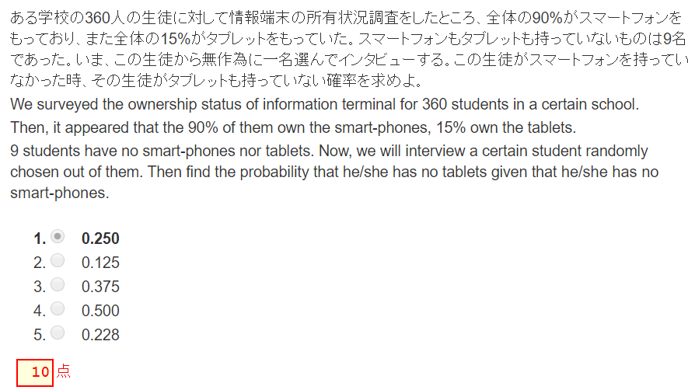


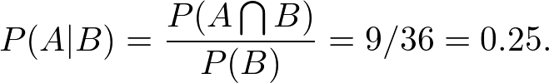
A:’タブレット無し’ ‘Has no tablet.’
B:スマホ無し’ ‘Has no smart-phone’.
 | Has smart-phone | No smart-phone
Has tablet |  |  | 360*0.15=54
No tablet |  | 9
 | 360*0.9=324 | 36 | 360

Slide 9
Week1_DAO

Slide 10
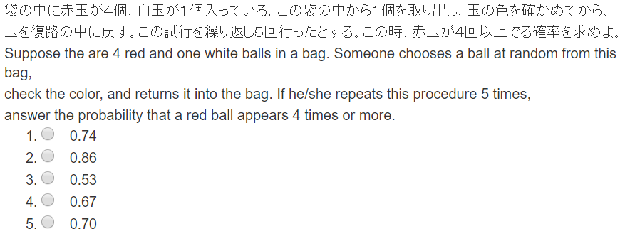

Slide 11
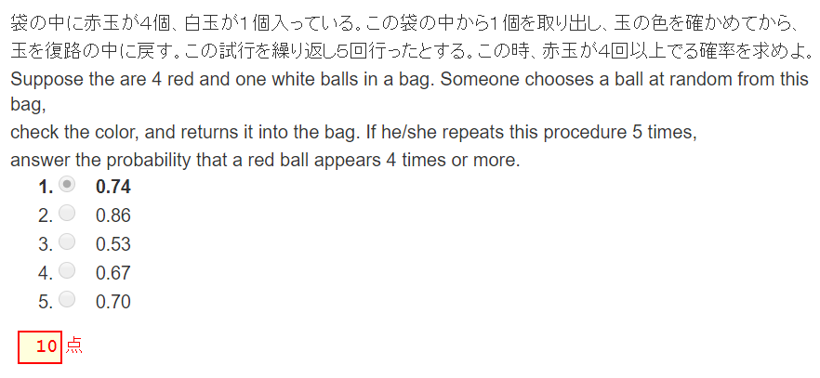


１回の試行あたり、赤が出る確率は4/5. For one trial, a red ball appears with probability 4/5.
よってちょうど4回赤が出る確率は
The red ball appear just 4 times out of 5 trials is:
よってちょうど5回赤が出る確率は
The red ball appear just 5 times out of 5 trials is:
これらを足せばよい。
Summing up these, we have the answer.

Slide 12
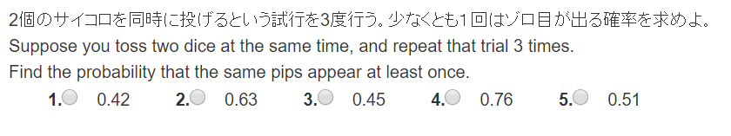

Slide 13
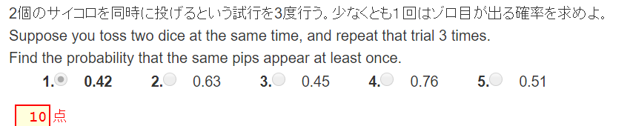


１回の試行あたり、ゾロ目となる確率は1/6. For one trial, the same pips appear with probability 1/6.
よって３度の試行でゾロ目が一度もでない確率は
Thus, the probability that the same pips never appear in 3 trials is:

Slide 14
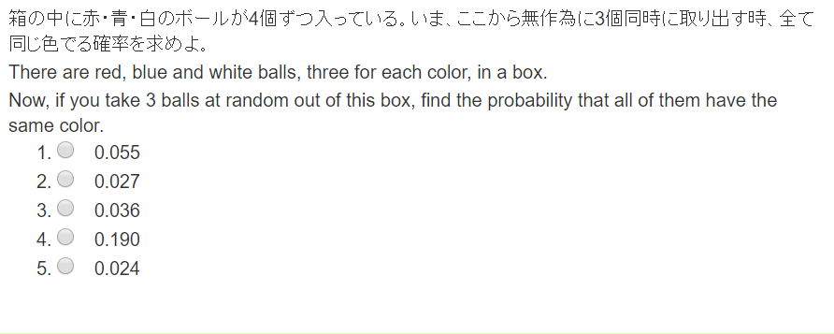

Slide 15
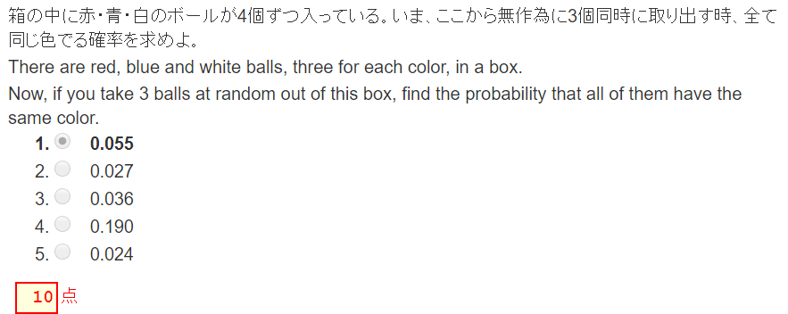


Slide 16
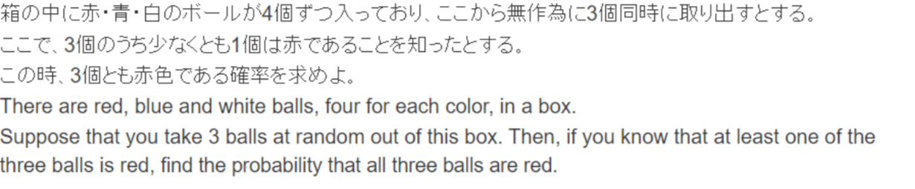
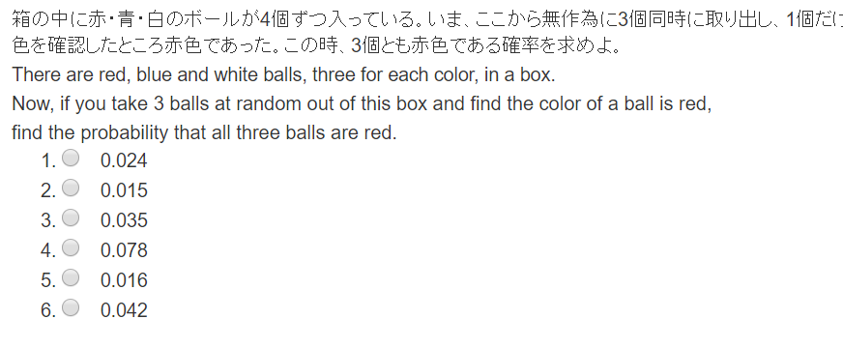

Slide 17
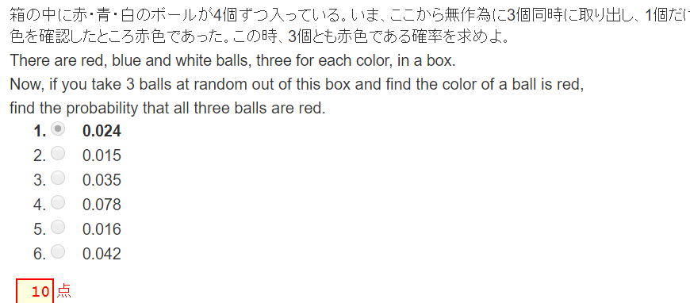


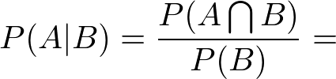

A:’3個とも赤’ ‘All of three taken out are red’.
B:’取り出した3個のうち少なくとも1個は赤’ ‘At least one ball out of three taken out is red’;

